Slide 1
Partial Information Tree Search Agents and Regret when Cooperating with Different Play Styles in Hanabi
Michael Brooks
Michael Brooks

Slide 2
Summary
Project:
Search-based agent implemented to play cooperative game “Hanabi”
Regret metric defined to identify which players cause lost score
Experiments performed where different agents play with themselves and with other players to track the score and regret achieved
Objectives:
Can search-based agents perform well when paired with different players?
Can regret help to explain the reason for particular score outcomes in the games?

Slide 3
Contents
1
2
3
4
5
6
7
8
Introduction
Hanabi
Search Methods
Methodology
Future Work
Results & Conclusions
References
Summary of Contributions

Slide 4
Introduction
Introduction
Why the subject of research?
Hanabi been declared one of the next frontiers for AI research¹
Intersects challenging aspects of effective game playing agents
Cooperation, partial information, restricted communication channel
Research split between “self-play”, where agent play with copies of itself, and “mixed-play”, agents play against different agents
Mixed-play strength means agent help weaker players
1 (Bard2020)
1

Slide 5
Hanabi
Hanabi
What is the game?
2 - 5 player cooperative card game
Setup: Deck of 50 cards, each with a rank 1 - 5 and one of 5 colours. 8 hint tokens. 3 life tokens
Goal: Work as a team to build up 5 fireworks of each colour consisting of cards that color from rank 1 through 5 . Overall score is the sum of the highest rank on each firework.
How: Each player dealt a hand. Go round performing one of three actions: Play on fireworks, Discard card or Hint information about another players hand
?
2

Slide 6
Hanabi
Hanabi
5
4
3
1
4
1
4
1
2
2
8
0
0
0
0
0
35
3
Hand is hidden from the player, but visible to teammates
2
2
1
4
5
2

Slide 7
Hanabi
Hanabi
“Graduate - You have a 1 - here!”
5
4
3
1
4
1
4
1
2
2
Hint
Telling a hint costs a hint token
8
0
0
0
0
0
35
3
Hints are only allowed to be one bit of information: a colour or rank
1
1
2
2

Slide 8
Hanabi
Hanabi
5
4
3
1
4
1
4
1
2
2
7
1
0
0
35
0
0
0
3
A card declared as ‘played’ is added to a firework if it is the next in sequence for that colour
1
1
1
2
Play
2

Slide 9
Hanabi
Hanabi
“Clown - You have two reds, here and here!”
5
4
3
1
4
1
4
1
2
2
Hint
Hints can’t be selective – all cards that have the hint property have to be revealed to the recipient
7
1
0
0
0
0
34
1
3
1
2
2

Slide 10
Hanabi
Hanabi
5
4
3
1
4
1
4
1
2
2
Play
1
Card sent to the discard pile
6
34
1
1
3
Wrongly playing a card that can’t be added to a firework loses a life token
1
2
2

Slide 11
Hanabi
Hanabi
5
4
3
2
4
4
4
1
2
2
Discarding gains a hint token
There are a limited number of each rank for each colour:
Rank 1: 3 copies
Rank 2: 2 copies
Rank 3: 2 copies
Rank 4: 2 copies
Rank 5: 1 copy
6
1
0
0
0
0
33
1
1
2
5
5
1
2
Discard
2

Slide 12
Hanabi
Hanabi
“Clown - You have two 2s, here and here!”
5
4
3
2
4
4
4
1
2
2
Hint
7
1
0
0
0
0
32
1
1
2
5
1
2
2

Slide 13
Hanabi
Hanabi
5
4
3
2
4
4
4
1
2
2
Play
2
6
1
0
0
0
0
32
1
1
2
5
1
2
2

Slide 14
Hanabi
Hanabi
5
4
3
2
4
4
4
1
2
3
6
2
0
0
0
0
32
1
2
2
5
“Clown - You have a 1, here!”
1
2
Hint
2

Slide 15
Hanabi
Hanabi
“Graduate - You have a green, here!”
5
4
3
2
4
4
4
1
2
3
Hint
5
2
0
0
0
0
32
1
2
2
5
1
2
2

Slide 16
Hanabi
Hanabi
5
4
3
2
4
4
4
1
2
3
Play
1
4
2
0
0
0
0
32
1
2
2
5
1
2

Slide 17
Hanabi
Hanabi
5
4
3
2
4
4
4
2
2
3
When last card is drawn, everyone only gets one more turn
Score is the sum of the fireworks
4
2
1
0
0
0
31
1
2
2
5
Losing all life tokens from failed plays results in score of 0
1
2
Aim: As a team, reach a high score
2

Slide 18
Monte Carlo Tree Search^{[1]}
Search Methods
How an agent can decide an action
Nodes = Game states
Edges = Actions
Each node tracks number of visits N and reward Q
Build the search tree by repeating 4 processes
After time or roll-out (iterations) limit, choose child of root with best average reward
Selection: Choose path to a selected node (UCT[^{2]})
Expansion: Add child to selected node
Simulation: Play out a game from child node
Backpropogation: Update N and Q for nodes in path
Q
[1] Kocsis et al. 2006, [2] Kocsis & Szepesvari 2006
3

Slide 19
Information Set MCTS^{[1]}
Search Methods
MCTS adapted for partial information
Partial Information: agent doesn’t know current game state
Keep tree structure, but nodes are “information sets”, collection of possible states
Information set defined by actions to get there
Each roll-out now needs determinisation, filling in missing information to define current game state for root node
= game state
[1] Cowling, Powley & Whitehouse 2012
3

Slide 20
Regret
Search Methods
Agent action regret
Regret ≔ Max Score Before Action – Max Score After Action
TeamRegret ≔ Sum of Cumulative Regret for all agents
Agent Regret Source | Description
Discard | Discarding all copies of a card
Play | Playing an incorrect card when all other copies discarded
End Game | Using last life token
Score = 25 – TeamRegret ?
3

Slide 21
Framework
Methodology
Hanabi framework released by Google Deep mind^{[1]}
Python reinforcement learning wrapper for C++ game engine
Allows stepping through actions, receiving observations
Allows implementation of Agents
[1] Deep Mind 2018
4

Slide 22
Framework Changes
Methodology
Allowing State Manipulation
Need to fill in partially unknown hand, “determinise”
Two new moves implemented in C++ engine
Return: Put cards back into the ‘deck’ of possible cards
DealSpecific: Deal new valid card into the hand
Can now use IS-MCTS in framework
5
3
2
4
3
Return
22
DealSpecific
5
4
3
2
4
4

Slide 23
Rule-Based Agents
Methodology
Logical Agents from the Literature
Rule-based agents follow set of logical condition rules to decide what to do
Most had already been implemented in framework^{[1],[2]}
Agent | Behaviour
Flawed^{[3]} | Reckless plays, random hints
Inner^{[4]} | Safe plays, only remembers own hints
Outer^{[4]} | Safe plays, remembers own and others’ hints
IGGI^{[3]} | Safe plays, predictable discards
Piers^{[3]} | Similar to VDB with hail mary & hint limit
Van Den Bergh (VDB)^{[5]} | Developed through genetic optimisation of rules
Mute | VDB without ability to hint (new here)
4
[1] rocanaan 2019 , [2] Canaan 2020, [3] Walton-Rivers et al. 2017, [4] Osawa, [5] van den Bergh (2015)

Slide 24
Search-Based Agents
Methodology
Implementing IS-MCTS variants
Implemented ‘MCTS’^{[1]} as an Information-Set Monte Carlo Tree Search with: 100 rollout limit, 3 simulation steps, expansion branching restriction rules^{[2]}, VDB agent in simulations, Score as Q
Variations were also tested
Variation | Behaviour
Regret | Q = Score – New TeamRegret
reD^{[2]} | Redeterminise other player hands
MCTS<Agent> | <Agent> in simulations
NoRules | No branching rules to restrict expansion step
NowConvention | Assume hint about single card means playable
4
[1] Brooks 2020, [2] Goodman et al. 2019

Slide 25
Experiments
Methodology
Experimental process to evaluate agents
3 player games
Experiment: Self-Play. All agents the same.
Experiment: Mixed-Play. Pair one rule-based agent of varying strength with two copies of a different agent
250 games for rule-based, 100 games for search-based
Ran on Queen Mary’s Apocrita HPC facility
Track: Score, TeamRegret, Agent Regret, Agent Regret Source
4

Slide 26
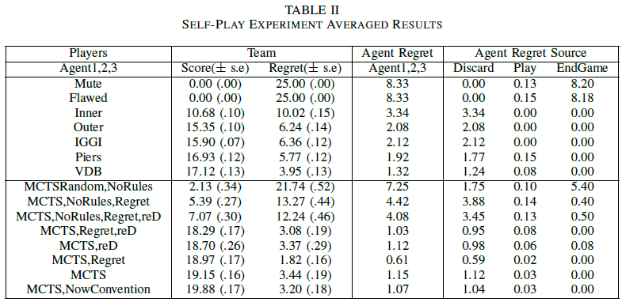
Self-Play
Results & Conclusions
Best search-based outperforms best rule-based
Branching rules and VDB for simulation drastically improve search-based score
Redeterminising beneficial without branching rules, but detrimental with
Regret Source shows where weak agents are losing score
5

Slide 27
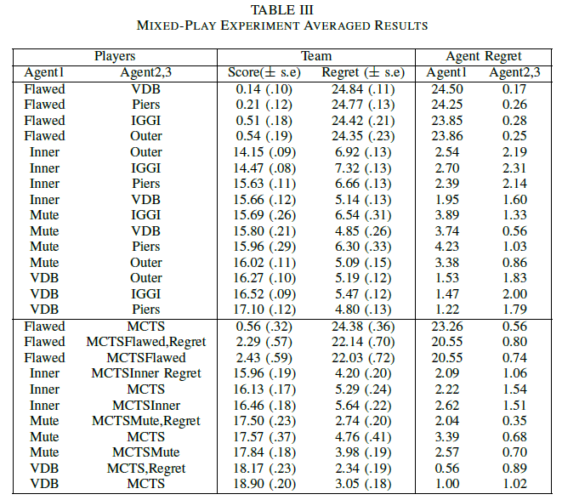
Mixed-Play
Results & Conclusions
Generally, mixed-play average score is between self-play scores. Mute and Outer are counter examples though
Conclude: Self-play performance only indicative of mixed-play performance; complementary strategies exist
Search –based achieve better scores than rule-based against all agents
Conclude: Search-based agents offer robust option for performant mixed-play
MCTS<Agent> always marginally scores better than MCTS.
Conclude: Search-based agents have added ‘opponent model’ adaptation benefit
5

Slide 28
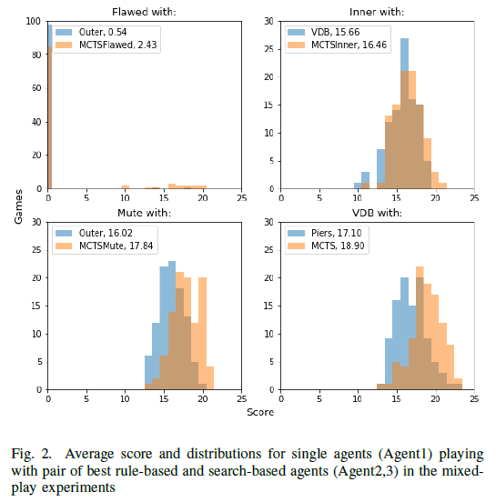
Rule-Based vs. Search-Based
Results & Conclusions
Mixed Play
5

Slide 29
Regret
Results & Conclusions
For Insight
Agent regret higher for weaker agents and agent regret source breaks down where agents lose potential score
Conclude: Regret can be used to explain why certain agents are weak and where they need to improve
Agent regret of the weaker self-play agent is almost always higher in mixed-play
Conclude: Regret can identify weaker agent in mixed-play without needing to know self-play performance
5

Slide 30
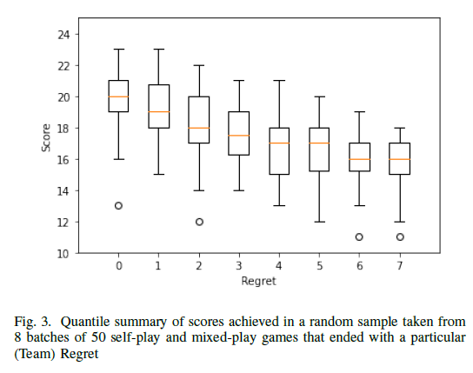
Regret
Results & Conclusions
For Performance
TeamRegret generally lower when better scores achieved
Conclude: Higher score and lower TeamRegret coincide
Score always lower when searching with a TeamRegret penalty
Conclude: Minimising agent action regret NOT the same as maximising score and more commonly leads to higher RemainingScorePotential (playable cards left in hand)
Score = 25 - TeamRegret
- RemainingScorePotential
5

Slide 31
Future Work
Future Work
Include RemainingScorePotential into the action regret definition (difficult combinatorics problem)
Agent learning to adapt over different episodes with a particular team (or after being shown team history of games)
Study agent compatibility and strength in different Hanabi variations (6 suits, sequential hints, rainbow suit)
6

Slide 32
Summary of Contributions
Theory
Implementation
Summary of Contributions
Agent Strength Insight: Search-based robust in mixed-play compared to rule-based
Agent Strength Insight: Self-play strength only indication of mixed-play strength; complementary strategies exist
New Metric Definition: Regret defined for Hanabi
Regret Insight: Quantitative method to infer weaker agents and why certain scores were achieved
New Moves: “Return” and “DealSpecific” moves integrated into C++ framework, allowing direct state manipulation in a forward model
Search Agent: Redeterminising Information Set Monte Carlo Tree Search created in a new framework, from the ground up
Stat Tracking: Way to track and store more detailed information about games developed
New Agent: Mute
7

Slide 33
Demonstration
Human playing a 3-player game with search based agents in the framework

Slide 34
THANKS
Michael Brooks
michaelj.brooks@outlook.com
Please keep this slide for attribution

Slide 35
References
References
Bard, N., Foerster, J. N., Chandar, S., Burch, N., Lanctot, M.,Song, H. F., Parisotto, E., Dumoulin, V., Moitra, S., Hughes,E. et al. (2020), ‘The hanabi challenge: A new frontier for ai research’, Artificial Intelligence 280, 103216.
Brooks, M. (2020), ‘mcts-hanabi github [online]’. URL: https://github.com/MBlogs/mcts-hanabi [accessed 2020-09-02],.
Canaan, R., Gao, X., Chung, Y., Togelius, J., Nealen, A. & Menzel, S. (n.d.), ‘Evaluating rl agents in hanabi with unseen partners’.
Cowling, P. I., Powley, E. J. & Whitehouse, D. (2012), ‘Information set monte carlo tree search’, IEEE Transactions on Computational Intelligence and AI in Games 4(2), 120–143.
DeepMind, G. (2018), ‘hanabi-learning-environment github [online]’. https://github.com/deepmind/hanabi-learning-environment [accessed 2020-08-06].
Goodman, J. (2019), Re-determinizing mcts in hanabi, in ‘2019 IEEE Conference on Games (CoG)’, IEEE, pp. 1–8.
Kocsis, L. & Szepesv´ari, C. (2006), Bandit based monte-carlo planning, in ‘European conference on machine learning’, Springer, pp. 282–293.
Kocsis, L., Szepesv´ari, C. & Willemson, J. (2006), ‘Improved monte-carlo search’, Univ. Tartu, Estonia, Tech. Rep 1.
Osawa, H. (2015), Solving hanabi: Estimating hands by opponent’s actions in cooperative game with incomplete information, in ‘Workshops at the Twenty-Ninth AAAI Conference on Artificial Intelligence’.
rocanaan (2019), ‘hanabi-ad-hoc-learning github [online]’. URL: https://github.com/rocanaan/hanabi-ad-hoc-learning [accessed 2020-08-06].
van den Bergh, M. J., Hommelberg, A., Kosters, W. A.& Spieksma, F. M. (2016), Aspects of the cooperative card game hanabi, in ‘Benelux Conference on Artificial Intelligence’, Springer, pp. 93–105.
Walton-Rivers, J., Williams, P. R., Bartle, R., Perez-Liebana,D. & Lucas, S. M. (2017), Evaluating and modelling hanabi playing agents, in ‘2017 IEEE Congress on Evolutionary Computation (CEC)’, IEEE, pp. 1382–1389.
8

